Slide 1
Anchorage in 1915
Significance in the world

Slide 2
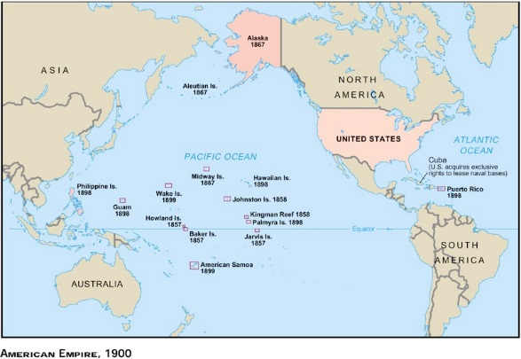
How broad themes play
out in particular places
X
Panama Canal 1903

Slide 3
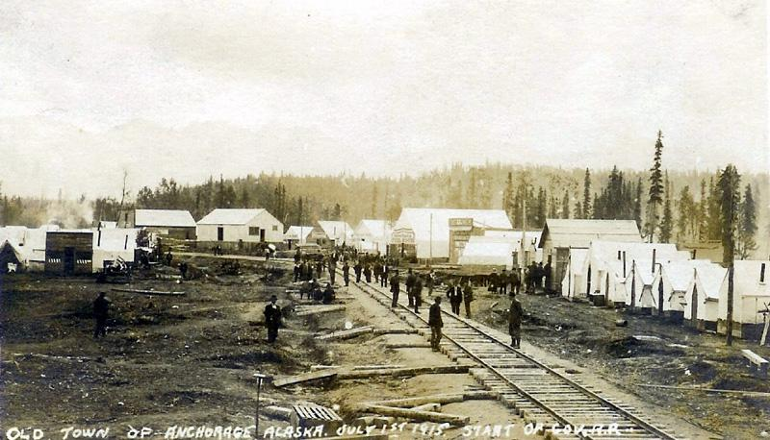
“The reason for Anchorage is the railroad…”
—Frank Carpenter, “Anchorage, A Boom City (1916)

Slide 4
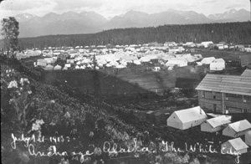
Matanuska
Alaska City
Ship Creek
Winalaska
Gateway
Terminal

Slide 5
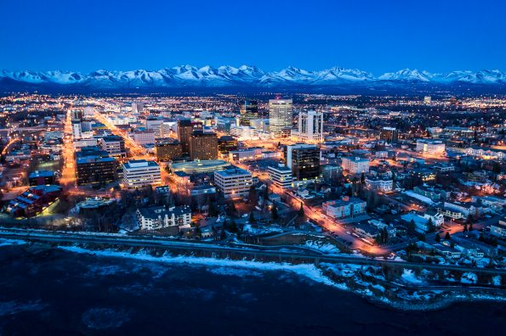

Slide 6
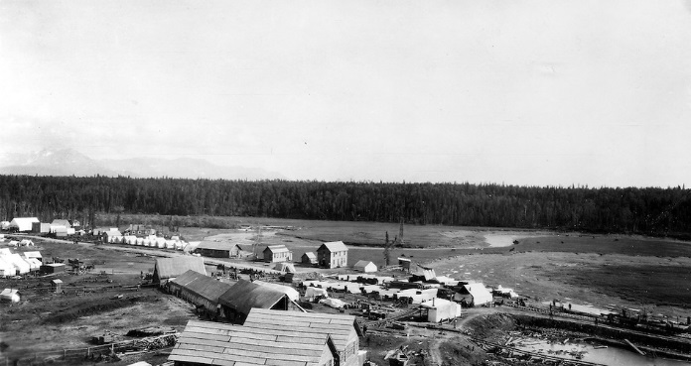

Slide 7
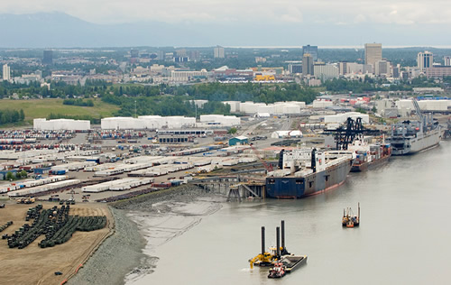

Slide 8
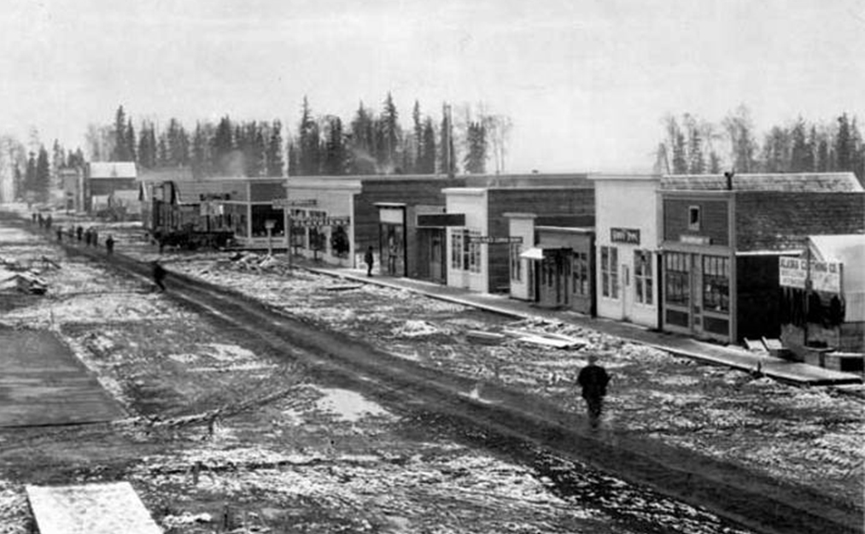

Slide 9
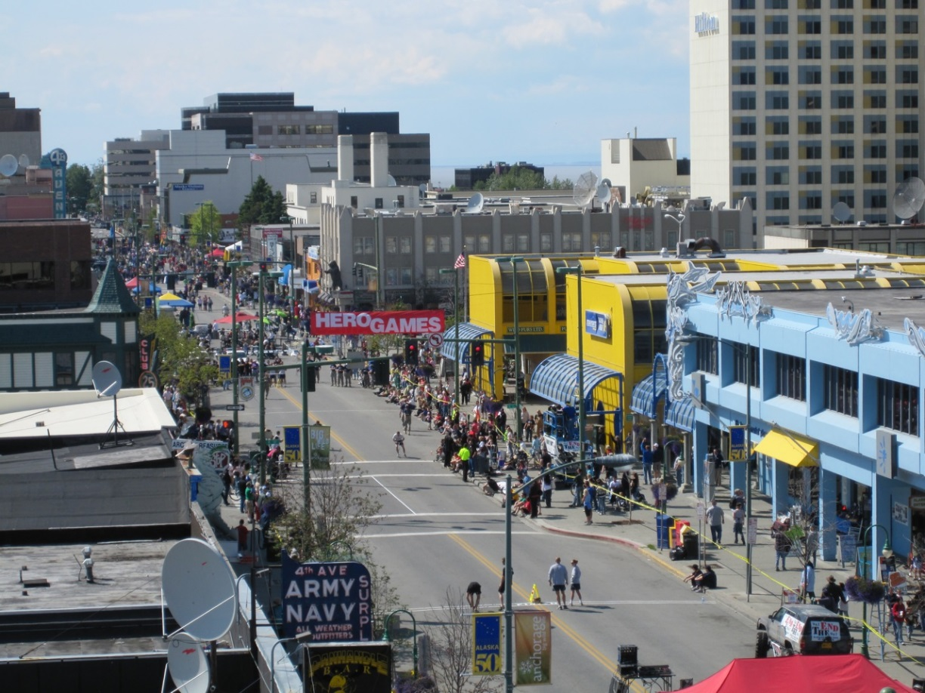

Slide 10
According to data from the Division of Permanent Fund Dividend (2011), there are at least 61 Alaskans who are 100 years and older in the State, up from 40 in 2010. The oldest Alaskan is 104 years old. (This person did not give their consent to be acknowledged.) The following 20 Centenarians gave their consent to us to honor them publicly during Older Americans Month celebrations:
Magdalena Mappala - Anchorage
Jamie de GuzmanAnchorage
Johnny McCurryAnchorage
Anchorage
Austrid GarrettAnchorage
Alfredro AgronAnchorage
Alice LarsonAnchorage
Dorothy NorrisAnchorage
Doris McBurneyAnchorage
In 2011 at least nine people 100 years or older living in Anchorage.
—Permanent Fund data

Slide 11
Anchorage’s significance in 1915
Personal
Regional
National
International

Slide 12
“Anchorage will evolve into one of the important commercial centers of Alaska.” —Cook Inlet Pioneer, June 5, 1915
Personal Interest
Government provides a framework
Individuals make it happen
  public/private joint venture

Slide 13
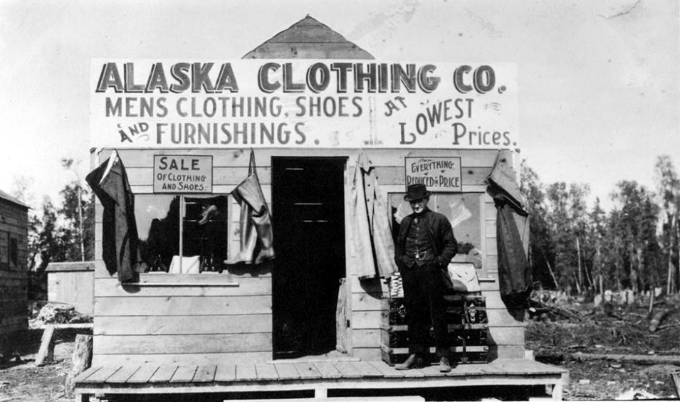
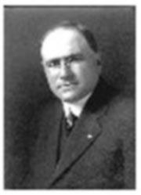
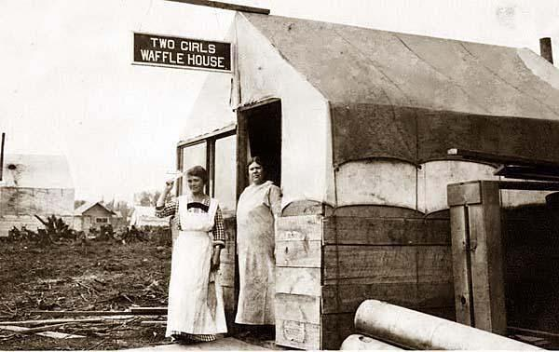
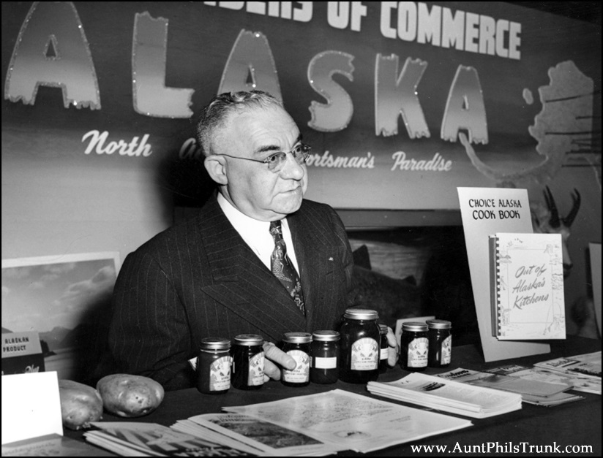
Leopold David
First mayor of Anchorage (1920-1923)
Soldier
Business manager
Lawyer
U.S. Marshal

Slide 14
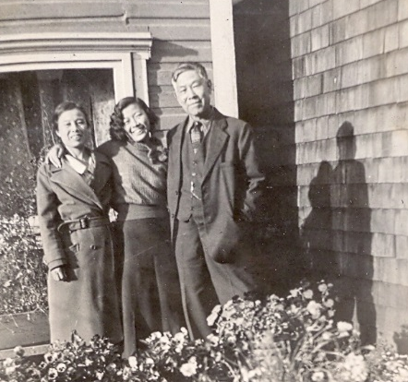
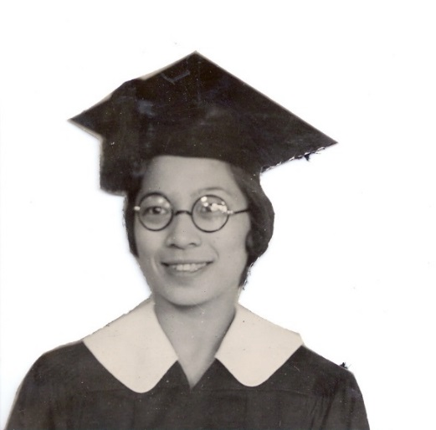
Mikami Family
Anchorage school yearbook
Anchorage Museum
Tailor business
Private collection

Slide 15
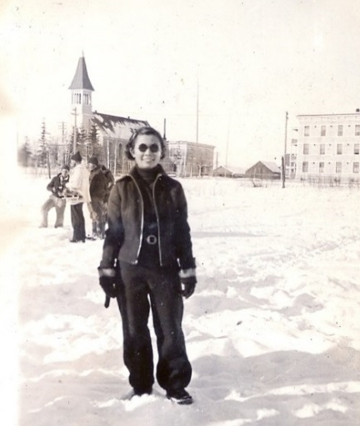


Anchorage’s beginning was important to individuals because it presented them with new opportunities

Slide 16
According to data from the Division of Permanent Fund Dividend (2011), there are at least 61 Alaskans who are 100 years and older in the State, up from 40 in 2010. The oldest Alaskan is 104 years old. (This person did not give their consent to be acknowledged.) The following 20 Centenarians gave their consent to us to honor them publicly during Older Americans Month celebrations:
Magdalena Mappala - Anchorage
Jamie de GuzmanAnchorage
Johnny McCurryAnchorage
Anchorage
Austrid GarrettAnchorage
Alfredro AgronAnchorage
Alice LarsonAnchorage
Dorothy NorrisAnchorage
Doris McBurneyAnchorage
Regional Interest

Slide 17
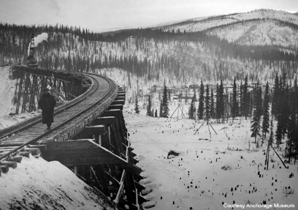
Anchorage enjoys the distinction of being the starting point of this huge commercial enterprise… the opening of… dormant mining and agricultural resources…
—Cook Inlet Pioneer, June 5, 1915
Morning Oregonian (Portland),
August 10, 1913

Slide 18
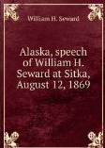
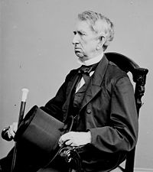
marine treasures….salmon, cod, and other fishes…. cedar… furs….limestone and marble…. coal….quartz…gold…
Secretary of State
William Seward

Slide 19
More gold than California
More coal than Pennsylvania
470 times the size of Rhode Island
(actually 425 times)
Wilkes-Barre Times-Leader
April 22, 1915

Slide 20
Congressional vote
to approve building
of the Alaska Railroad
(1914)
U.S. House of Representatives
230 to 87
72.5% in favor

Slide 21
Finally, the government is taking Alaska seriously….

Slide 22
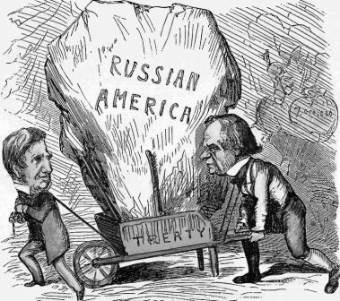
Undoing (the myth of) “Seward’s Folly”
…a brief digression

Slide 23
“An outburst of newspaper condemnation and sarcasm”
“storm of opprobrium”
1883

Slide 24
Vote for the Alaska Purchase
U.S. Senate: 37 to 2 95% in favor
U.S. House: 113 to 48 70% in favor
not very controversial

Slide 25
Seward’s Folly =
Alaskans reading into history their frustration with a government that seemed uninterested in developing Alaska’s tremendous natural wealth
…and the story, repeated over and over, gains a life of its own

Slide 26
We’re right in the center of the hub.
Coal, fish, gold, copper, farm products
at our front and back door. —Cook Inlet Pioneer, July 1915
Everything is coming to Anchorage, that favored town, situated amidst
the most wonderful resources of Alaska.
—Alaska Labor News, April 14, 1917

Slide 27
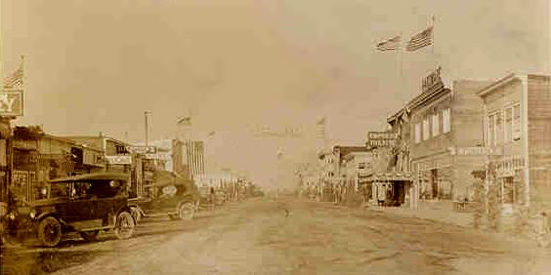
Anchorage’s beginning was important regionally because it suggested the territory was going to be developed—and this meant the end of national neglect.

Slide 28
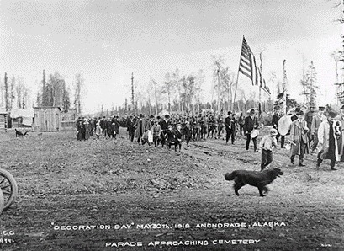
According to data from the Division of Permanent Fund Dividend (2011), there are at least 61 Alaskans who are 100 years and older in the State, up from 40 in 2010. The oldest Alaskan is 104 years old. (This person did not give their consent to be acknowledged.) The following 20 Centenarians gave their consent to us to honor them publicly during Older Americans Month celebrations:
Magdalena Mappala - Anchorage
Jamie de GuzmanAnchorage
Johnny McCurryAnchorage
Anchorage
Austrid GarrettAnchorage
Alfredro AgronAnchorage
Alice LarsonAnchorage
Dorothy NorrisAnchorage
Doris McBurneyAnchorage
National Interest

Slide 29
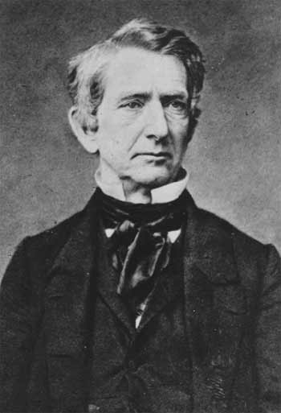
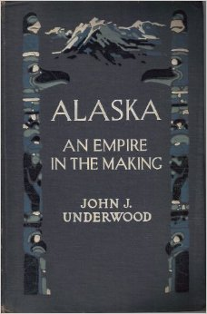
million acres of coal lands….
Coal-beds, accessible to navigation, are found [in Southeast Alaska]…. There are also mines at Cook's Inlet.

Slide 30
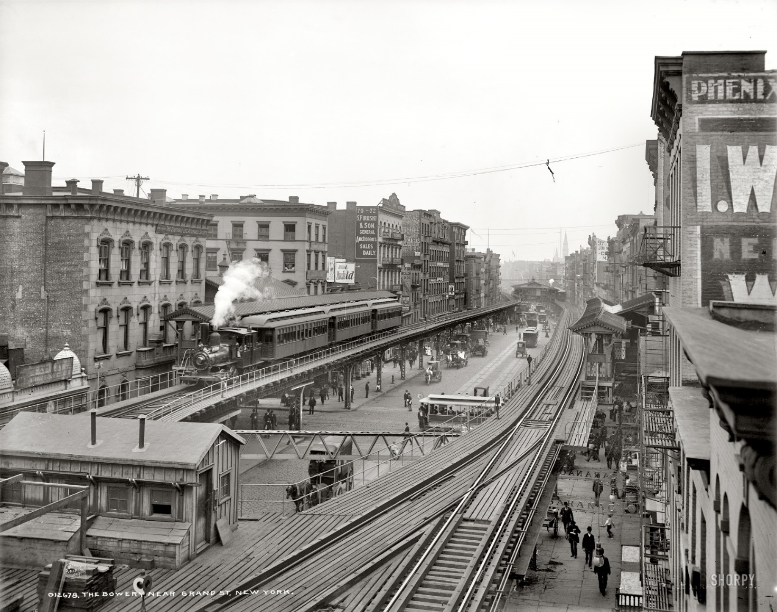
According to data from the Division of Permanent Fund Dividend (2011), there are at least 61 Alaskans who are 100 years and older in the State, up from 40 in 2010. The oldest Alaskan is 104 years old. (This person did not give their consent to be acknowledged.) The following 20 Centenarians gave their consent to us to honor them publicly during Older Americans Month celebrations:
Magdalena Mappala - Anchorage
Jamie de GuzmanAnchorage
Johnny McCurryAnchorage
Anchorage
Austrid GarrettAnchorage
Alfredro AgronAnchorage
Alice LarsonAnchorage
Dorothy NorrisAnchorage
Doris McBurneyAnchorage
“Coal is essential to industry
and personal comfort”
“UAF uses a coal plant
for all space heating…”
—Usibelli report
Lexington Herald, November 7, 1917

Slide 31
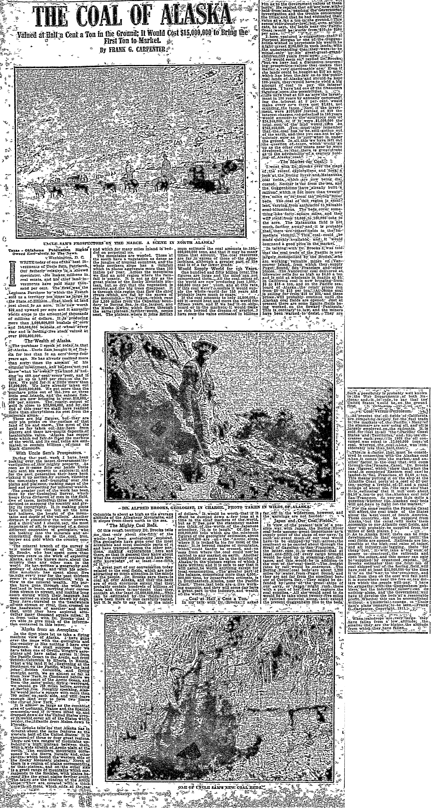
Dallas Morning News, May 14, 1911

Slide 32
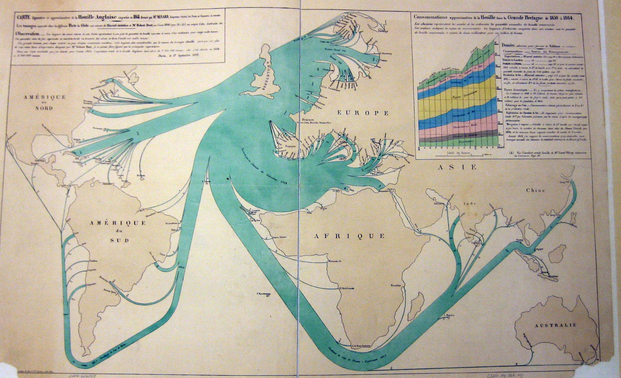
British coal exports
Desire in the U.S.
for greater national self-sufficiency
(energy independence)

Slide 33
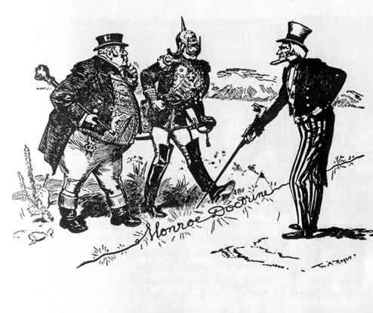
Mastery in the western hemisphere
A leading role in the Pacific

Slide 34
Kansas City Star (Missouri),
May 5, 1911
Olympia Daily Recorder,
May 5, 1911

Slide 36
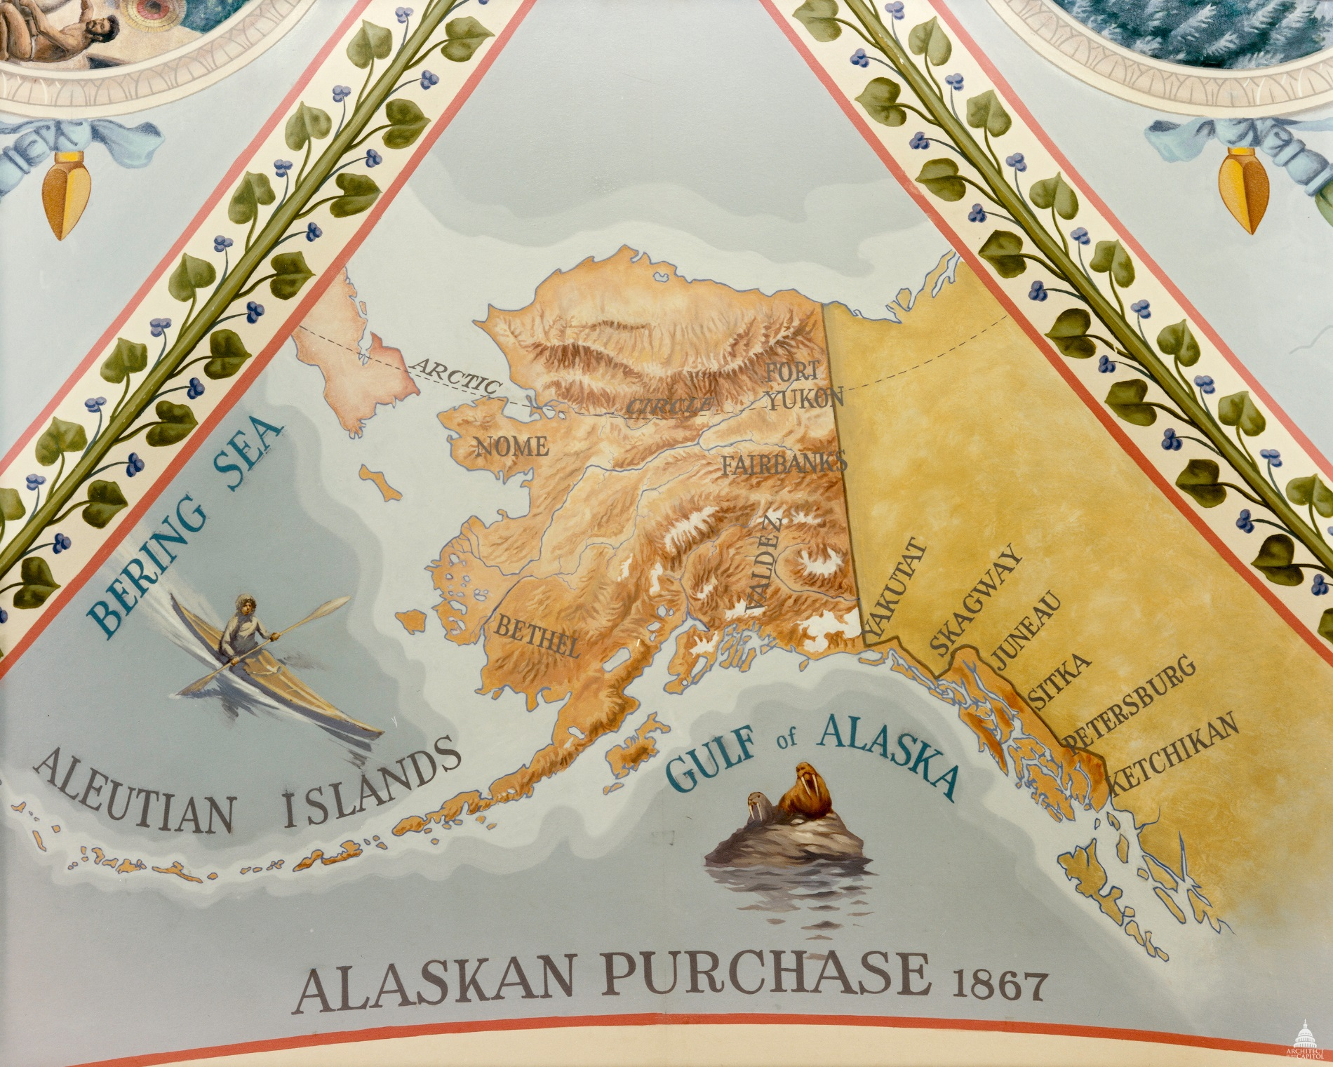
Anchorage’s beginning was important nationally because Alaska had natural resources that would help to make the U.S. wealthier & more self-sufficient.

Slide 37
According to data from the Division of Permanent Fund Dividend (2011), there are at least 61 Alaskans who are 100 years and older in the State, up from 40 in 2010. The oldest Alaskan is 104 years old. (This person did not give their consent to be acknowledged.) The following 20 Centenarians gave their consent to us to honor them publicly during Older Americans Month celebrations:
Magdalena Mappala - Anchorage
Jamie de GuzmanAnchorage
Johnny McCurryAnchorage
Anchorage
Austrid GarrettAnchorage
Alfredro AgronAnchorage
Alice LarsonAnchorage
Dorothy NorrisAnchorage
Doris McBurneyAnchorage
International Interest

Slide 38
X
Panama Canal 1903

Slide 39
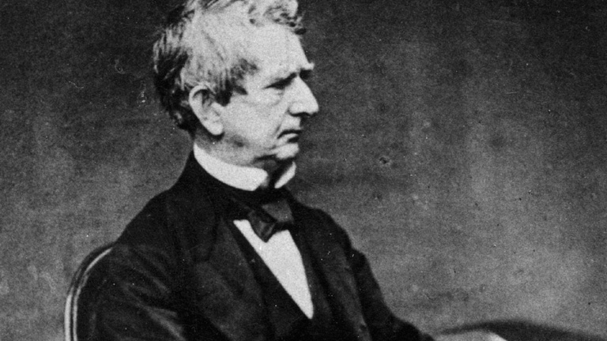
“…the supply of furs in Alaska…. demand for them in China and elsewhere has immensely increased….”

Slide 40
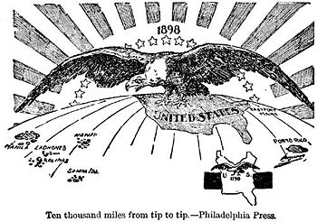
…from the Arctic shores of Alaska to…Puerto Rico…and the tropical possession of the [Philippines] in the Far East.” —Frederick Hoffman, statistician (1914)

Slide 41
Alaska links
the U.S. and East Asia

Slide 42
“Alaska…is defended
by Hawaii.”
—Congressman Clarence B. Miller (R-MN), September 1915
…and Hawaii is defended by the Navy…
…and the Navy needs coal…
Aberdeen Sunday American News
(South Dakota), November 20, 1921

Slide 43
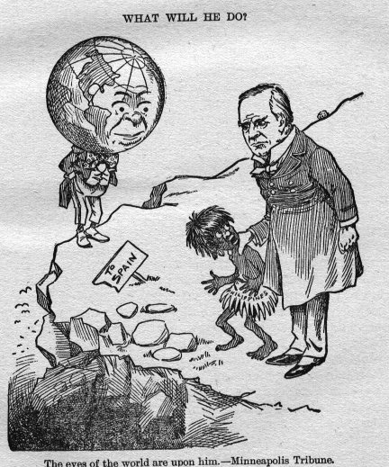
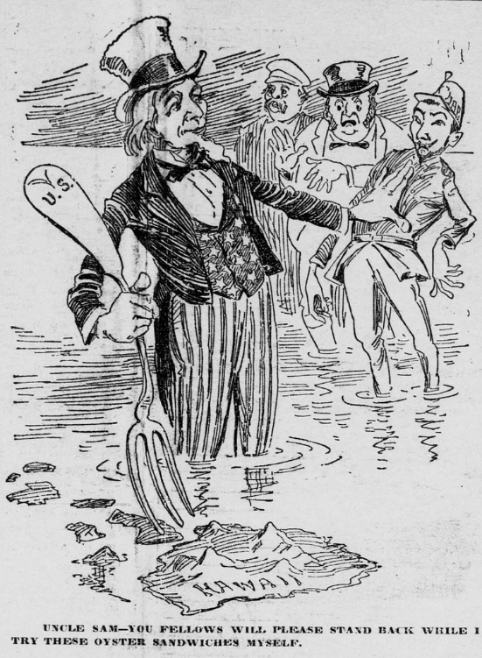
“G. Shinowasa, editor of a Japanese
newspaper published at Seattle, visited
this week.” —Cook Inlet Pioneer, June 12, 1915

Slide 44
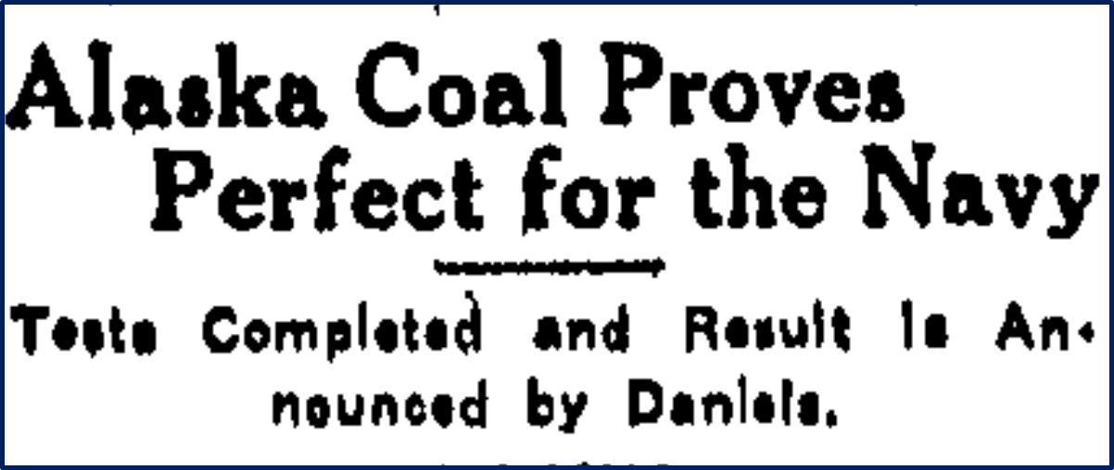
The State (Columbia, South Carolina),
December 14, 1914
San Jose Mercury Herald, April 16 14, 1915
San Jose Mercury Herald,
December 15, 1914

Slide 45
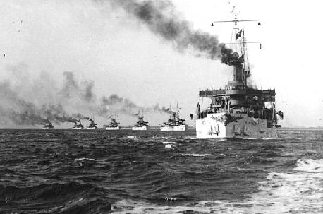
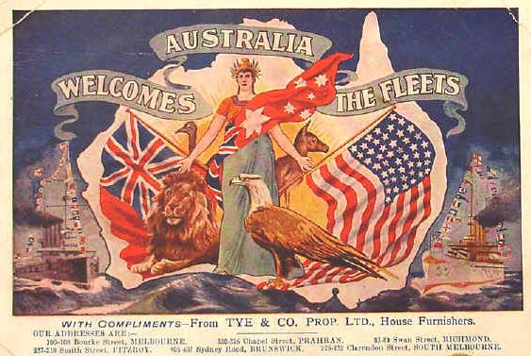
“For naval purposes alone construction of a railroad in Alaska is fully justified.”
—U.S. Representative William E. Humphrey (R-WA)
...and the railroad would be headquartered in Anchorage

Slide 46
Like a queen on her throne, [Anchorage] rests on the shore, her railroad and her steamship lines extending as two arms filled to overflowing with the abundance of the world’s commerce and industry. —Alaska Labor News, April 14, 1917

Slide 47
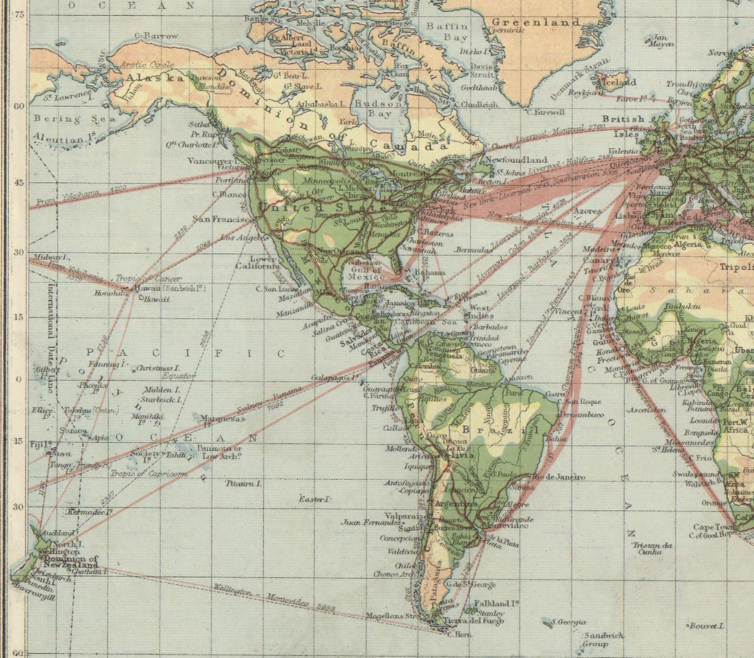
Anchorage’s beginning was important internationally because it gave the U.S. another platform on the Pacific from which to trade and project American power.

Slide 48
“Anchorage should in time become
a great industrial city.” —Weekly Alaskan, June 13, 1916

Slide 49
“Anchorage should
in time…”

Slide 50
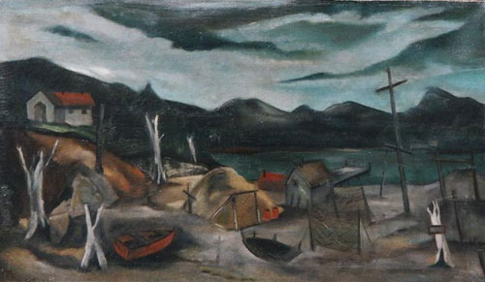
Disappointments
First World War
Duluth News Tribune, January 16, 1914
Great Depression
Depopulation (c. 5,000 in early 1917 to c. 2,000 in 1920)
  Going to war & leaving for work Outside
Alaska ships diverted to war effort
Alaskan Fishing Village Dawn by Karl Fortess (c 1937);
WPA project in Alaska
Nenana Daily News,
January 4, 1918

Slide 51
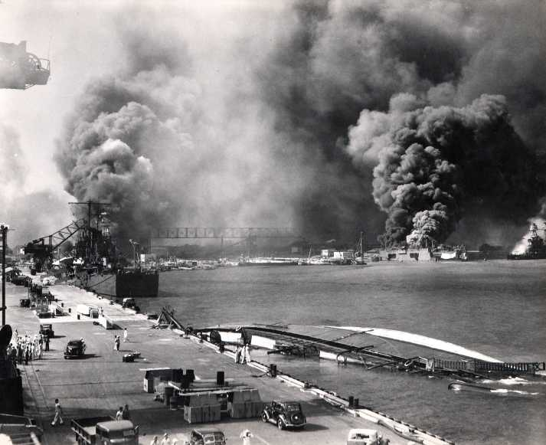
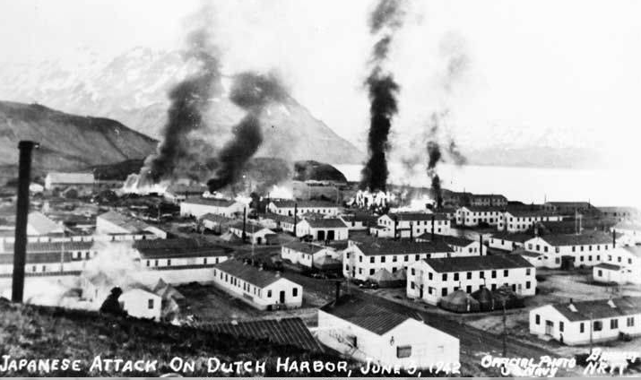
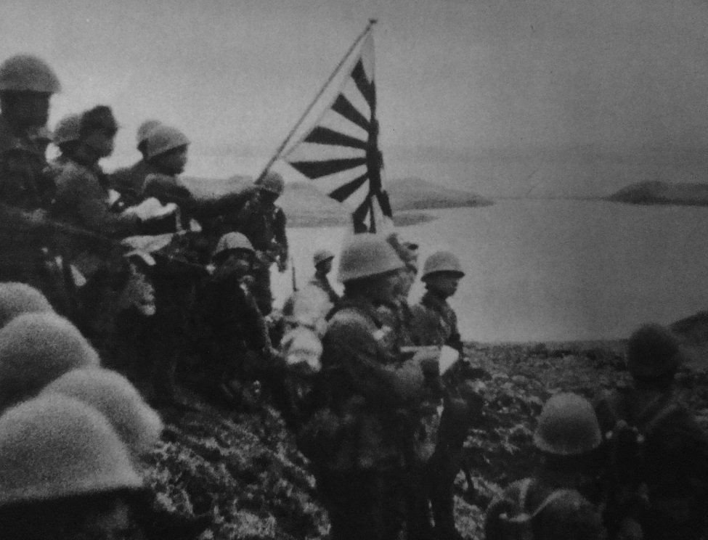
December 7, 1941
External jolt
June 3, 1942
Second World War

Slide 52
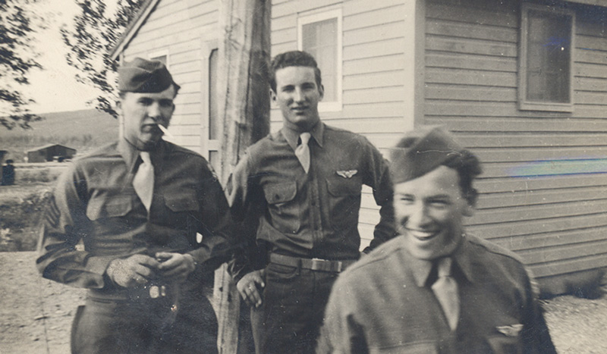
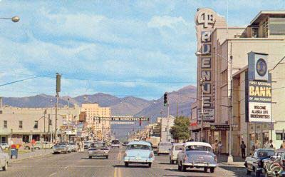
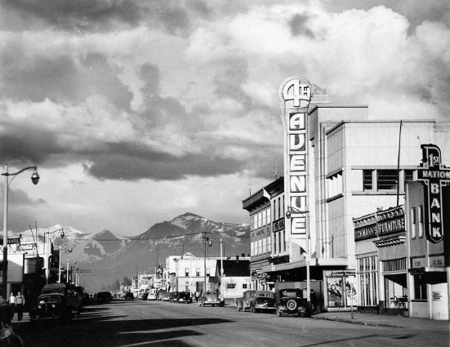
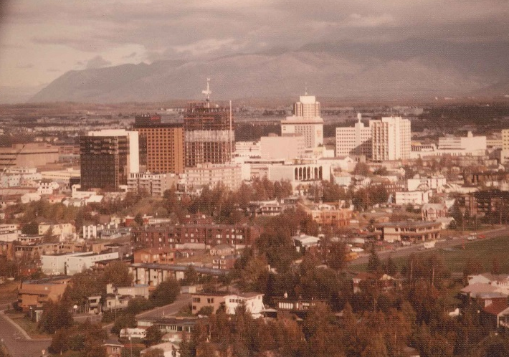

Slide 53
“Anchorage should in time become a great industrial city.”

Slide 54
Anchorage’s significance
then and now

Slide 55
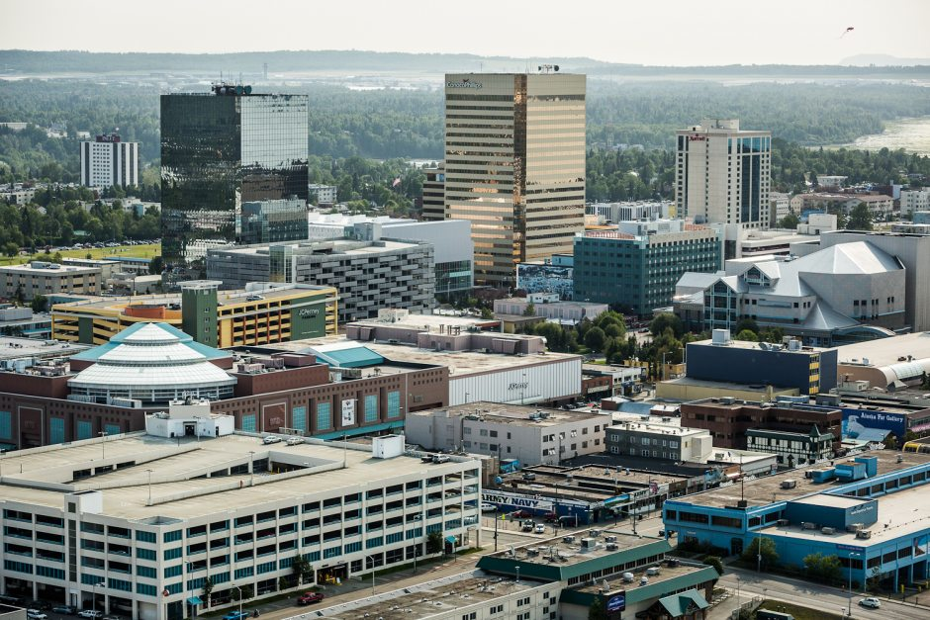
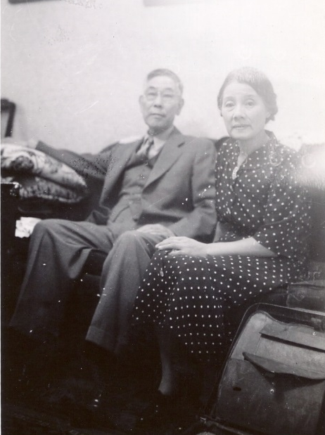
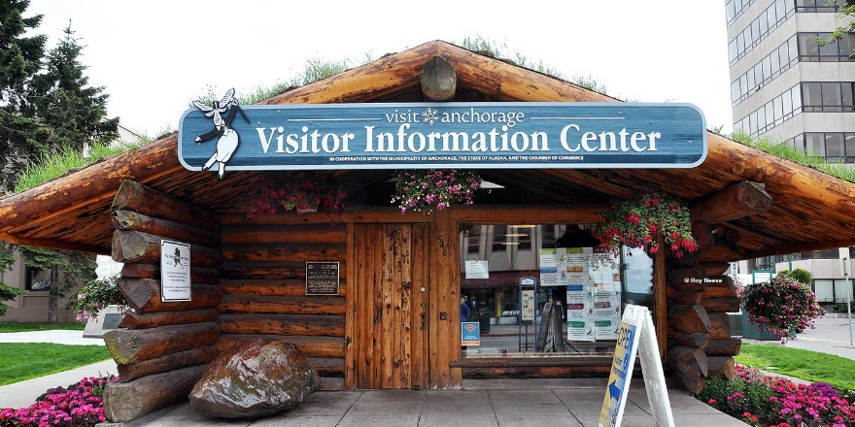
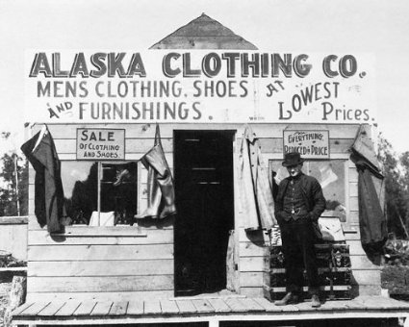
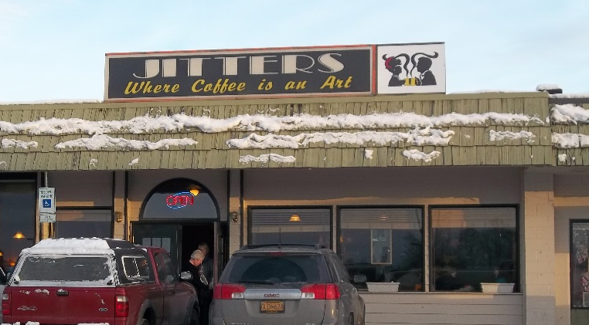

Personal

Slide 56
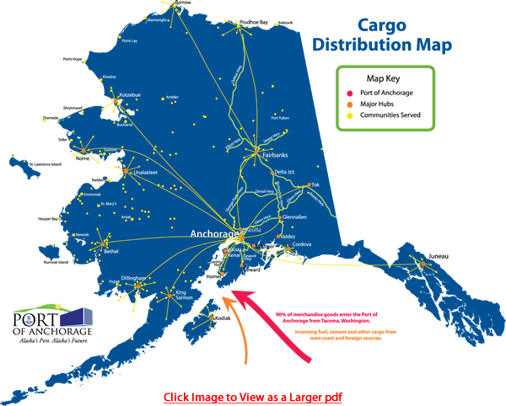


Regional

Slide 57

National
Alaska’s food and beverage industry contributes at least $828 million in value added to the [U.S.] economy.
—Grocery Manufacturers Association
In terms of weight landed, Anchorage’s airport is the
2nd busiest air cargo site in the U.S.
salmon… cod…. cedar… furs… limestone… marble… quartz… gold…

Slide 58


International

Slide 59





International
“For naval purposes alone construction of a railroad in Alaska is fully justified.”
—U.S. Representative William E. Humphrey (R-WA)
ADN

Slide 60

International

Slide 61
Anchorage’s significance in 1915—and now
Personal
Regional
National
International

Slide 62
“Anchorage should in time become a great industrial city. A great and mighty northern empire is just in the opening.” —Weekly Alaskan, June 13, 1916

Slide 63


Slide 64
Thank You

