Slide 1
Anchorage Chamber of Commerce Fall 2014 Revenue Forecast Discussion
December 15, 2014
Alaska Department of Revenue

Slide 2
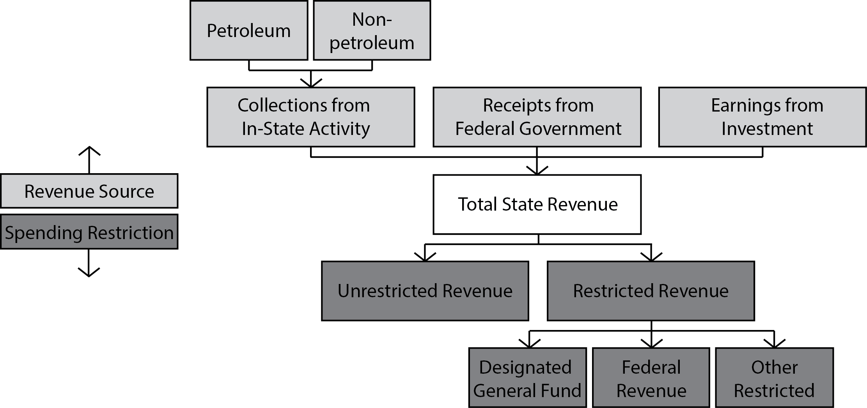
Revenue Categories

Slide 3
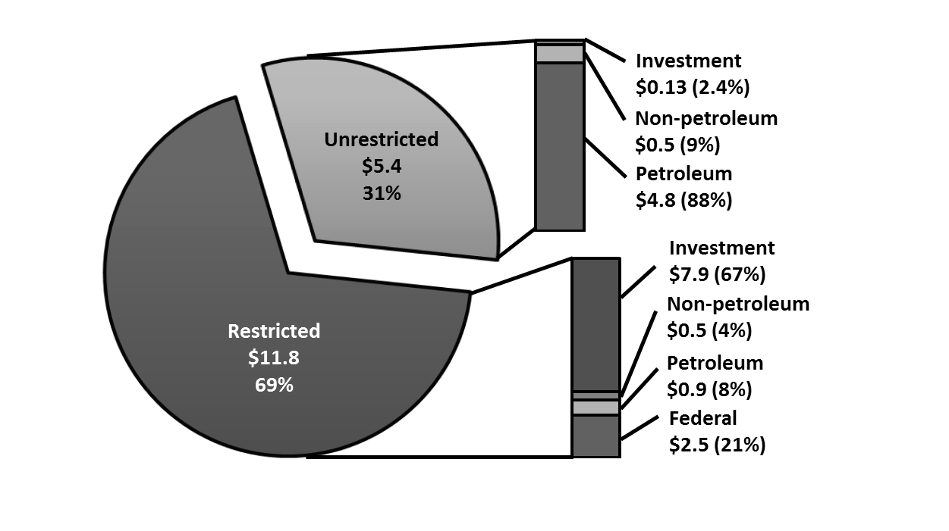
FY 2014 Total State Revenue, by restriction and type

Slide 4
Rethinking Oil Price Forecast for Last Half of FY 2015
Actual
Estimate

Slide 5
Recommended ANS Revenue Forecast Prices
FY 2015 & FY 2016 are from an internal DOR probabilistic pricing model.
FY 2017 and beyond are from the Fall 2014 price forecast session held on October 7, 2014.

Slide 6
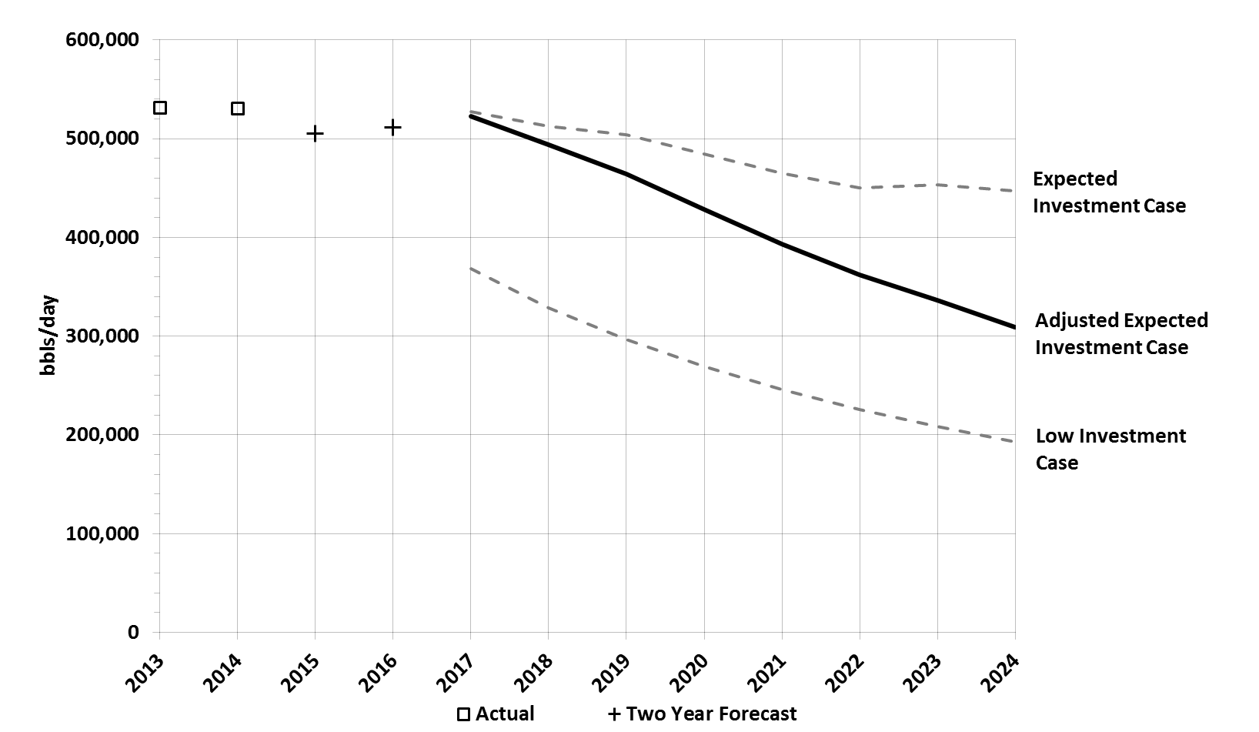
ANS Oil Production Forecast

Slide 7
Unrestricted Revenues and Budget 2015-2024
Using proposed Fall 2014 Revenue forecast
 | 2015 | 2016 | 2017 | 2018 | 2019 | 2020 | 2021 | 2022 | 2023 | 2024
ANS WC Oil Price ($/bbl) | 76.31 | 66.03 | 93.18 | 102.81 | 112.00 | 117.36 | 121.14 | 123.87 | 129.04 | 134.39
Total ANS Production (State + Federal) (MMbbls/day) | 509.5 | 524.1 | 534.1 | 503.5 | 473.2 | 435.8 | 400.4 | 368.5 | 342.9 | 314.7
Deductible Lease Expenditures ($ millions) | 7,049 | 7,273 | 7,096 | 6,569 | 6,087 | 5,734 | 5,654 | 5,291 | 4,959 | 4,642
General Fund Unrestricted Revenues ($ millions) | 2,551 | 2,197 | 3,657 | 4,292 | 4,808 | 4,853 | 4,628 | 4,556 | 4,548 | 4,473
General Fund Expenditure from OMB ($ millions)* | 6,106 | 5,684 | 5,600 | 5,600 | 5,600 | 5,600 | 5,600 | 5,600 | 5,600 | 5,600
Budget Surplus/Deficit ($ millions)* | (3,533) | (3,487) | (1,943) | (1,308) | (792) | (747) | (972) | (1,044) | (1,052) | (1,127)
Source: Department of Revenue - Revenue Sources Book Fall 2014; preliminary FY 2016 10-year plan
* Expenditure and surplus / deficit information are based on preliminary FY 2016 10-year plan numbers. FY 2015 surplus / deficit calculation includes $21.5 million in carry-forward revenue. Budget estimates subject to revision.
7

Slide 8
Depletion of Savings Accounts
Fall 2014 Revenue Forecast ($ millions)
Source: Department of Revenue - Revenue Sources Book Fall 2014; preliminary FY 2016 10-year plan
* Expenditure and surplus / deficit information are based on preliminary FY 2016 10-year plan numbers. FY 2015 surplus / deficit calculation includes $21.5 million in carry-forward revenue. Budget estimates subject to revision.

Slide 9
FY 2015-2017 General Fund Unrestricted Revenue, with Price Sensitivity

Slide 10
Questions?

Slide 11
Alaska North Slope Crude West Coast Price

Slide 12
Total Revenue Forecast – FY 2015 & 2016
($ millions) | Actual | Fall 2014 Forecast
Revenue Type | FY 2014 | FY 2015 | FY 2016
Unrestricted General Fund
Oil Revenue | 4,755.3 | 2,019.2 | 1,636.1
Non-Oil Revenue* | 508.5 | 502.3 | 528.2
Investment Revenue | 130.2 | 30.0 | 32.4
Total Unrestricted Revenue | 5,394.0 | 2,551.5 | 2,196.7
Designated General Fund
Non-Oil Revenue* | 289.6 | 323.1 | 322.1
Investment Revenue | 66.3 | 20.4 | 35.8
Subtotal | 355.9 | 343.5 | 357.9
Other Restricted Revenue
Oil Revenue (Restricted royalties, CBRF settlements, etc) | 927.6 | 512.9 | 465.6
Non-Oil Revenue (Taxes, licenses, fines, etc)* | 183.9 | 229.2 | 230.4
Investment Revenue (Permanent Fund, CBRF, etc) | 7,861.4 | 3,322.2 | 3,549.8
Subtotal | 8,972.9 | 4,064.3 | 4,245.8
Federal Revenue
Oil Revenue | 6.8 | 5.0 | 5.0
Federal Receipts | 2,511.9 | 3,126.4 | 3,126.4
Subtotal | 2,518.7 | 3,131.4 | 3,131.4
Total State Revenue | 17,241.5 | 10,090.7 | 9,931.8
*Except Federal and Investment
12
Source: Department of Revenue - Revenue Sources Book Fall 2014

