Slide 1
Documenting Indigenous Knowledge on Tlingit Seal Hunting for Future Generations
Yakutat Seal Camp Project
Smithsonian Spotlight October 2014
Judith Ramos, M.A.T.
Assistant Professor DANSRD UAF
Indigenous Studies PhD Student, UAF

Slide 2
Harbor Seals -Tsaa
Harbor Seals are an important marine and cultural resource for Alaska Natives and are apex-level predator
In 2008 an estimated 1,462 Harbor seals were taken in Alaska for subsistence purpose (ADFG).
Yakutat ranks first in the harvest of Harbor Seals in Southeast Alaska. My 2001 Yakutat Subsistence survey found 262 Harbor Seals were harvested, 36% of the Native household harvested seals and 78% used seals.

Slide 3
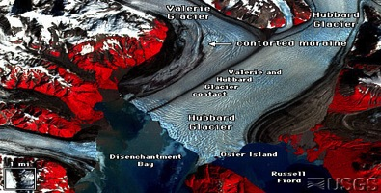
“Sacred Relations” Story of People and Place
Honoring our connections to the mountains and glaciers of our area
We believed that glaciers and mountains had spirits we called glacier spirits “Sit’tu Kwaani”.

Slide 4
Blessing of Place and Maintaining Balance

Slide 5
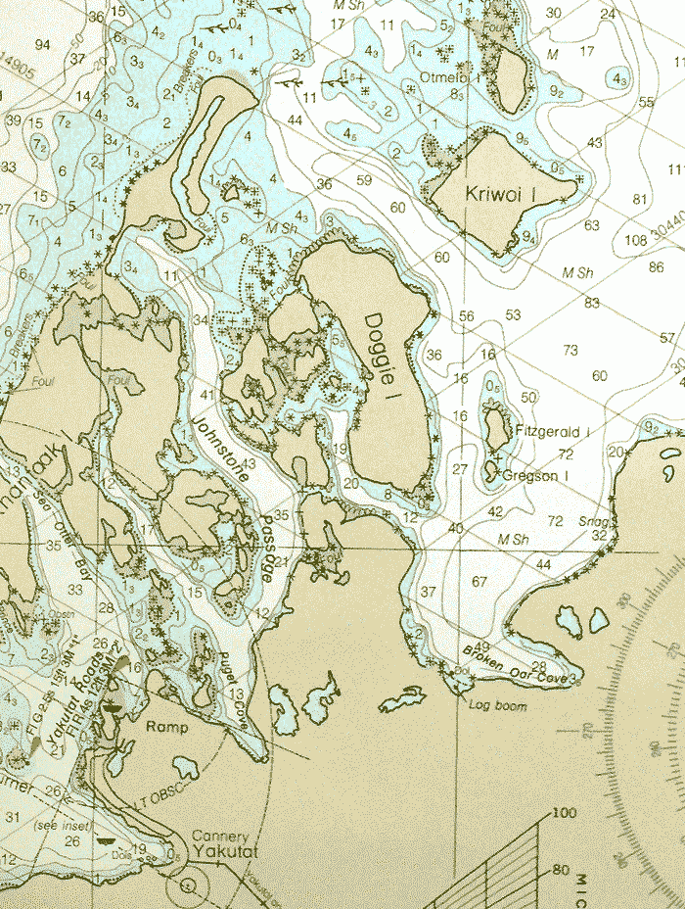
Oral tradition, Geological Change and Cosmology Lingit Aani (our world) was created by Yeil (Raven). Raven’s jealous uncle Dis (Moon) caused a great flood that “forced people into canoes and onto the tops of the highest mountains. A number of clan origin stories begins with this event
After the retreat of the glaciers, Tlingit people began migrating into and settling Southeast Alaska. “Late Wisconsin advances along the northern Pacific coast began about 25,000 BP, with deglaciation beginning … 14,000 BP” (Davis 1995).
My clan’s migration story began when we formerly lived in the interior of Alaska. We traveled over glaciers and migrated down the coast to Yakutat. When we came to Yakutat “there was a glacier across Yakutat Bay from Pt. Manby to Kriwoi Island” (H.B.). This glacier is now know as Malispina/Hubbard Glacier.

Slide 6
Sit Tléin- Hubbard Glacier "When they got there it was a foreign country. They didn’t know what to eat or how to live so the spirits of that place adopted them. They adopted the humans by showing them how to hunt seal. The humans became part of that glacier. They became friends of the spirit of the glacier. That is why we have a special connection with the glaciers and the mountains in all that area.” Elaine Abraham

Slide 7
Place and Being
Yakutat place names are in the Eyak and Tlingit language and two names are in Aleut.
Place names refer to environmental change. Khantaak Island is called Gantáḵw, meaning Lupine in Eyak, the name came from a time when there were no trees on the Island.
Clans acquire their names from place. Oral history recounts the stories of how they acquired their name. My clan’s second name came from Humpy Creek in Yakutat Bay – Kwaashk’ikwaan (Kwaashk’I is Humpy in Eyak and Kwaan is people of in Tlingit).
http://www.nps.gov/wrst/planyourvisit/images/SAM_1031edit.jpg

Slide 8
Tlingit place names (toponyms) recorded for the Yakutat Bay region

Slide 9
Traditional Clan Management of Resources
Southeast Alaska is divided into 13 (tribal) territories called Kwaan. Each Kwaan is sub-divided into (Eagle and Raven moiety) clan territories that governed, managed and monitored the land, resources and water.
The clan leader and council monitored and protected the clan’s hunting and fishing territories, he determined when, where, and with what weapons his people and others might hunt or fish and how many animals each man might take.

Slide 10
Traditional Harvest and Use of Seal
Photo of Jenny Abraham fleshing seal, hides being stretched and dried, as well as smoked seal flippers, Harriman Expedition 1899 (Bur. Amer, Ethnol. Neg. No. 43547-D)
The role of men and women
Traditional training of hunters
Equipment and techniques used
Method of hunting, selection of animals, season and hunting areas
Traditional methods for processing seal and hide
Traditional names for seal anatomy

Slide 11
Seal Grease bowl
What is the role of Harbor Seal in the subsistence economy of the Yakutat in the past and the present?
What is the role of values and beliefs in conservation and ethical-moral hunting and conservation practices?

Slide 12
Seal Camp Hubbard Glacier Harriman Expedition 1899
Traditionally the whole village went up to Hubbard Glacier in the spring time to harvest and process seals.
Seal oil or seal grease was used as a preservative for food

Slide 13
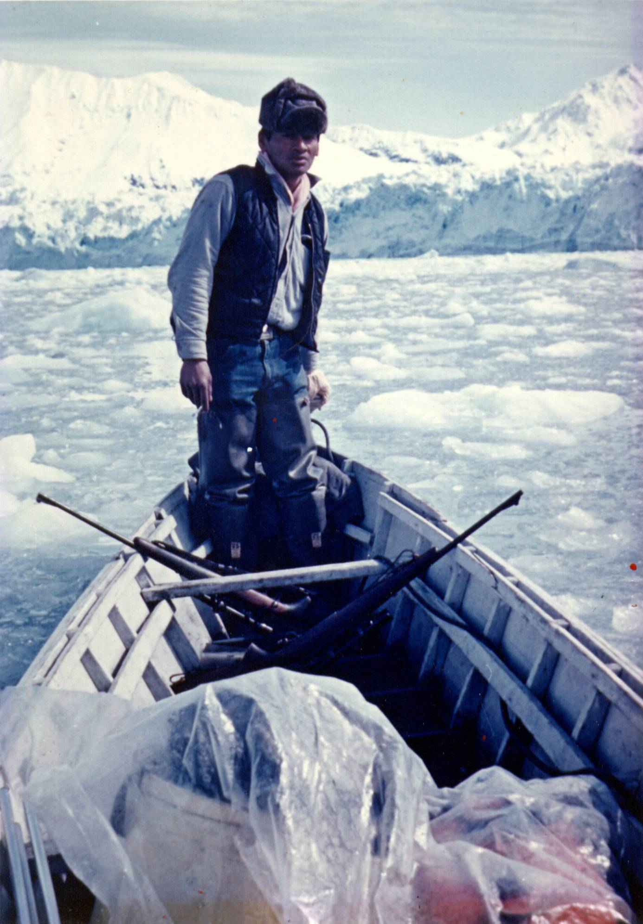
Indigenous Science and Knowledge on Seal hunting and Seals “George Ramos, Sr. described how seal hunting was carried out when he was young and by generations before. The hunters would use small dugout canoes to approach the seals among the ice floes, killing them with barbed spears and later (by the 1890s) with guns. In order to approach silently, they employed small underwater paddles or wore waterproof gloves made from seal skin and seal oil to trap in heat”

Slide 14
Goodi.yá - Traditional Yakutat seal hunting canoe (USNM 274,417, 76,276)
How did the Tlingit adapt their hunting to the ice-flow conditions of tide-water glaciers?
Double-ended, Prow is used in think ice, and the other end is used in ice free water

Slide 15
Hunters had to be aware of weather, currents and ice in order to hunt in the ice. Hunters had to be knowledgeable on seal behavior. “Today’s hunters travel in motorized skiffs and use small caliber, low-noise rounds to first pick off the “watcher” or sentry in a group of sleeping seals, and then continue hunting the rest of the unguarded group.”

Slide 16
Understanding water and currents

Slide 17
Spotting for seals

Slide 18
Here my father George Ramos explains the correct way to shoot a seal
“(the) seal throw his head back like that and the air comes out of his lung’s and he sinks. That is why you have to wait until they look away from you, hit him, and (it) pushes their head down”

Slide 19
Fleshing seals

Slide 20
Harvesting Sea Gull Eggs

Slide 21
Seal skin mocassin
Part of the money economy.

Slide 22
Beyond Researcher
Here is my family in the Summer of 2013, from left to right is my son Kai, my mother Chewshaa, me, my niece Nirvana and my father George.
Community Facilitator/Tribal Liaison
Understanding the local community, and environment
Family Support
Community and Tribal Accountability

Slide 23
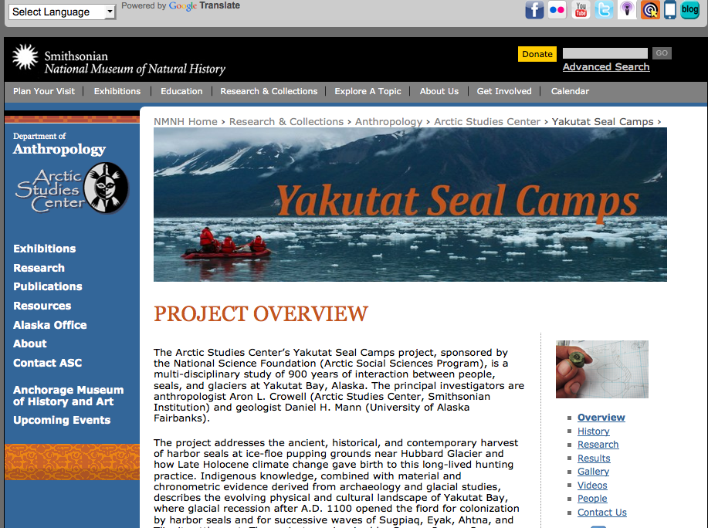
Sharing results
Seal hunting Video https://vimeo.com/41007415
The Glaciers' Eternal Gift: Traditional Ice Floe Sealing at Yakutat http://vimeo.com/84835688
Sealaska Corporation and YTT- curriculum and documentary
First Alaskan’s Magazine

Slide 24
Acknowledgements
Family
NSF Arctic Social Sciences Program
http://www.mnh.si.edu/arctic/html/Yakutat-seal-camps/index.html
Photos: Judith Ramos and Dr. Crowell
Dr. Aron Crowell http://www.mnh.si.edu/arctic/html/Yakutat-seal-camps/index.html
Dr. Langdon UAA
Yakutat Tlingit Tribe and Tribal Elders
Yakutat US Tongass National Forest
UAF Indigenous Studies Program, RAP, my Graduate Committee and DANSRD

